Slide 1
Chapter 2
UNIX Programming

Slide 2
Socket
Sockets allow communication between two different processes on the same or different machines.
A Unix Socket is used in a client-server application framework.
A server is a process that performs some functions on request from a client.
Most of the application-level protocols like FTP, SMTP, and POP3 make use of sockets to establish connection between client and server and then for exchanging data.

Slide 3
Socket Address Structure
A socket address structure is a special structure that stores the connection details of a socket.
It mainly consists of fields like IP Address, Port Number and Protocol family.
Socket Address Family determines the format of the address structure
Members of AF_INET address family are IPv4 addresses.
Members of AF_INET6 address family are IPv6 addresses.
Members of AF_UNIX address family are names of Unix domain sockets
Members of AF_IPX address family are IPX addresses, and so on.
The name of each socket starts with socketaddr_ followed by its unique name.

Slide 4
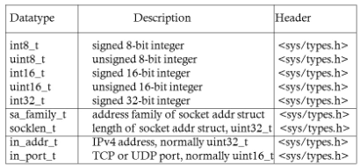
IPv4 Socket Address Structure
An IPv4 socket address structure, commonly called an "Internet socket address structure," is named sockaddr_in and is defined by including the <netinet/in.h> header.
Figure in next slide shows the POSIX definition of IPv4 socket address structure
POSIX or “Portable Operating System Interface for uniX” is a collection of standards that define some of the functionality that a (UNIX) operating system should support.
Datatypes required by Posix
Notes:
POSIX or “Portable Operating System Interface for uniX” is a collection of standards that define some of the functionality that a (UNIX) operating system should support.

Slide 5
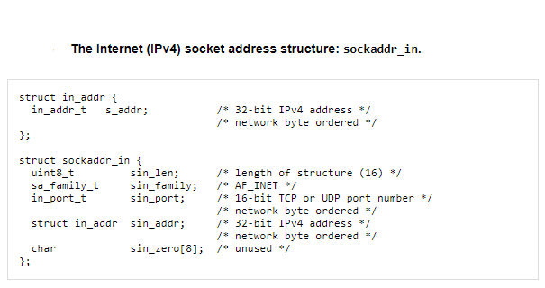
IPv4 Socket Address Structure
Notes:
Byte Ordered:
Network addresses in a given network must all follow a consistent addressing convention.
This convention, known as network byte order, defines the bit-order of network addresses as they pass through the network.
The TCP/IP standard network byte order is big-endian
A big-endian system stores the most significant byte of a word at the smallest memory address and the least significant byte at the largest. A little-endian system, in contrast, stores the least-significant byte at the smallest address

Slide 6
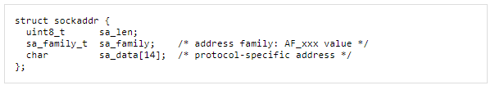
Generic Socket Address Structure
A socket address structures is always passed by reference when passed as an argument to any socket functions
But any socket function that takes one of these pointers as an argument must deal with socket address structures from any of the supported protocol families.
A problem arises in how to declare the type of pointer that is passed.
A generic socket address structure was defined in the <sys/socket.h> header, which was shown below.

Slide 7
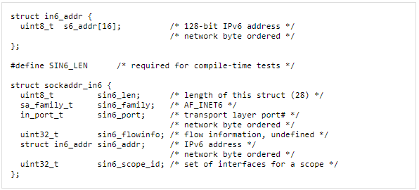
IPv6 Socket Address Structure
The IPv6 socket address is defined by including the <netinet/in.h> header

Slide 8
IPv6 Socket Address Structure
The SIN6_LEN constant must be defined if the system supports the length member for socket address structures.
The IPv6 family is AF_INET6, whereas the IPv4 family is AF_INET.
The members in this structure are ordered so that if the sockaddr_in6 structure is 64-bit aligned, so is the 128-bit sin6_addr member. On some 64-bit processors, data accesses of 64-bit values are optimized if stored on a 64-bit boundary.
The sin6_flowinfo member is divided into two fields:
The low-order 20 bits are the flow label
The high-order 12 bits are reserved
The sin6_scope_id identifies the scope zone in which a scoped address is meaningful, most commonly an interface index for a link-local address

Slide 9
New Generic Socket Address Structure
A new generic socket address structure was defined as part of the IPv6 sockets API, to overcome some of the shortcomings of the existing struct sockaddr.
Unlike the struct sockaddr, the new struct sockaddr_storage is large enough to hold any socket address type supported by the system.
The sockaddr_storage structure is defined by including the <netinet/in.h> header

Slide 10
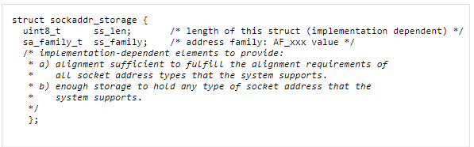
New Generic Socket Address Structure
The sockaddr_storage type provides a generic socket address structure that is different from struct sockaddr in two ways:
If any socket address structures that the system supports have alignment requirements, the sockaddr_storage provides the strictest alignment requirement.
alignment requirement, is an integer value of type size_t representing the number of bytes between successive addresses.
The sockaddr_storage is large enough to contain any socket address structure that the system supports.

Slide 11
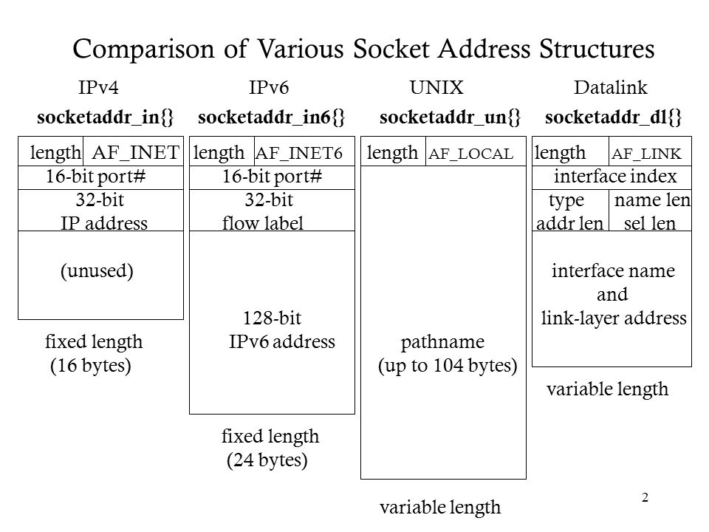
Notes:
All socket address structures contain a one-byte length field
All socket address structure contain o family field.
Two of the socket address structures are fixed-length, while the Unix domain structure and the datalink structure are variable-length.
To handle variable-length structures, whenever we pass a pointer to a socket address structure as an argument to one of the socket functions, we pass its length as another argument.

Slide 12
Value-Result Arguments
When a socket address structure is passed to any socket function, it is always passed by reference. That is, a pointer to the structure is passed.
The length of the structure is also passed as an argument.
But the way in which the length is passed depends on which direction the structure is being passed:
from the process to the kernel, or
vice versa.

Slide 13
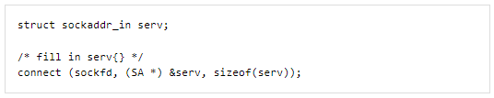
Value-Result Arguments(pass a socket address structure from the process to the kernel. )
Three functions, bind, connect, and sendto, pass a socket address structure from the process to the kernel.
One argument to these three functions is the pointer to the socket address structure and another argument is the integer size of the structure

Slide 14
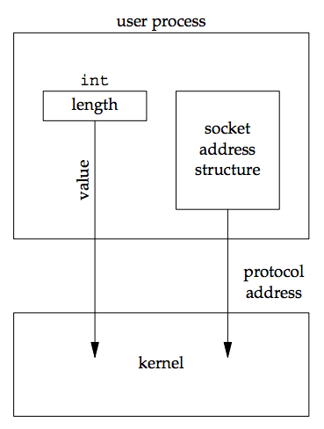
Value-Result Arguments(pass a socket address structure from the process to the kernel. )
Since the kernel is passed both the pointer and the size of what the pointer points to, it knows exactly how much data to copy from the process into the kernel.

Slide 15
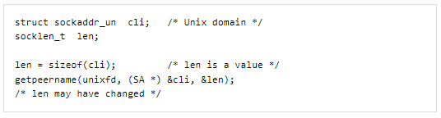
Value-Result Arguments(pass a socket address structure from the kernel to the process. )
Four functions, accept, recvfrom, getsockname, and getpeername, pass a socket address structure from the kernel to the process, the reverse direction from the previous scenario.
Two of the arguments to these four functions are the pointer to the socket address structure along with a pointer to an integer containing the size of the structure

Slide 16
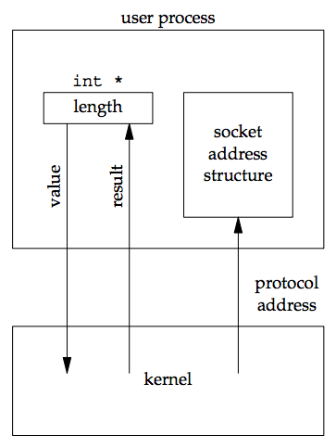
Value-Result Arguments(pass a socket address structure from the kernel to the process. )

Slide 17
Value-Result Arguments(pass a socket address structure from the kernel to the process. )
The reason that the size changes from an integer to be a pointer to an integer is because the size is both a value when the function is called (it tells the kernel the size of the structure so that the kernel does not write past the end of the structure when filling it in) and a result when the function returns (it tells the process how much information the kernel actually stored in the structure). This type of argument is called a value-result argument.

Slide 18
Value-Result Arguments
When using value-result arguments for the length of socket address structures,
if the socket address structure is fixed-length , the value returned by the kernel will always be that fixed size: 16 for an IPv4 sockaddr_in and 28 for an IPv6 sockaddr_in6, for example.
But with a variable-length socket address structure (e.g., a Unix domain sockaddr_un), the value returned can be less than the maximum size of the structure (

Slide 19
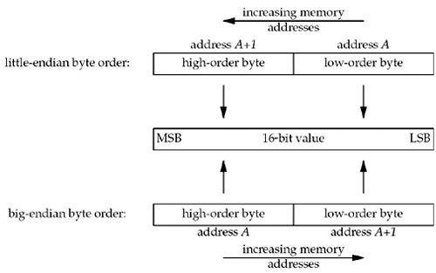
Byte Ordering Functions
Consider a 16-bit integer that is made up of 2 bytes.
There are two ways to store the two bytes in memory:
with the low-order byte at the starting address, known as little-endian byte order, or
with the high-order byte at the starting address, known as big-endian byte order.

Slide 20
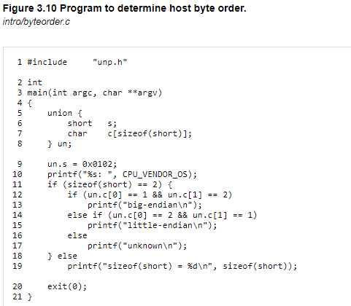
BYTE ORDERING FUNCTIONS: HOST BYTE ORDER
Unfortunately, there is no standard between these two byte orderings and we encounter systems that use both formats.
We refer to the byte ordering used by a given system as the host byte order.
Notes:
The 0x is just a notation to let you know the number is in hexadecimal form.

Slide 21
Byte Ordering Functions
Big endian and little endian are two different ways of ordering bytes in multi-byte data types such as integers, floats, and doubles. In big endian byte order, the most significant byte (MSB) comes first and is stored at the lowest memory address, while in little endian byte order, the least significant byte (LSB) comes first and is stored at the lowest memory address. For example, the 16-bit integer value 0x1234 would be stored in big endian byte order as 12 34 and in little endian byte order as 34 12.
The choice of byte order can affect how data is interpreted by different computer architectures and can impact the interoperability of systems communicating over a network. Most modern computer architectures, including x86 and ARM, use little endian byte order, while older architectures such as SPARC and PowerPC use big endian byte order.
When communicating data over a network, it is important to use a standardized byte order to ensure interoperability between different systems. Network byte order is defined as big endian byte order, and functions such as htons(), htonl(), ntohs(), and ntohl() are provided in the standard C library to convert between host byte order and network byte order.

Slide 22
Byte Ordering Functions
Byte ordering functions are used in network programming on Unix systems to convert values between host byte order and network byte order, which is big-endian.
The following byte ordering functions are commonly used:
htons() and ntohs(): These functions convert 16-bit values between host byte order and network byte order. The "h" in htons() and ntohs() stands for "host" and the "n" stands for "network". For example, htons(0x1234) would convert the 16-bit value 0x1234 to network byte order.
htonl() and ntohl(): These functions convert 32-bit values between host byte order and network byte order. The "l" in htonl() and ntohl() stands for "long". For example, htonl(0x12345678) would convert the 32-bit value 0x12345678 to network byte order.
The reason for using these functions is that different computer architectures may represent multi-byte values differently, with some using little-endian byte ordering and others using big-endian byte ordering. Network byte order, which is big-endian, is used as a standardized format for communication between different systems. By converting values to network byte order before sending them over the network and converting them back to host byte order after receiving them, programs can ensure that the values are interpreted correctly regardless of the architecture on either end of the communication.

Slide 23
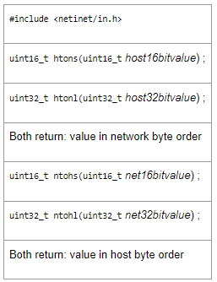
Conversion of network to host byte order and vice versa

Slide 24
Byte Manipulation Functions
Byte manipulation functions are commonly used in network programming in C to manipulate individual bytes within larger data structures such as integers, strings, and IP addresses. Some commonly used byte manipulation functions in network programming include:
memcpy(): This function is used to copy a block of memory from one location to another. It is often used to copy data to or from network buffers. The prototype for memcpy() is void *memcpy(void *dest, const void *src, size_t n), where dest is a pointer to the destination memory location, src is a pointer to the source memory location, and n is the number of bytes to copy.
memset(): This function is used to set a block of memory to a specified value. It is often used to initialize network buffers to a specific value. The prototype for memset() is void *memset(void *s, int c, size_t n), where s is a pointer to the memory location to set, c is the value to set the memory to, and n is the number of bytes to set.
htonl(), htons(), ntohl(), and ntohs(): These functions were discussed in the previous answer and are used to convert between host byte order and network byte order.
inet_aton(): This function is used to convert an IPv4 address string in dotted-decimal notation to a binary representation in network byte order. The prototype for inet_aton() is int inet_aton(const char *cp, struct in_addr *inp), where cp is a pointer to the IPv4 address string and inp is a pointer to a struct in_addr that will hold the binary representation of the address.
inet_ntoa(): This function is used to convert an IPv4 address in network byte order to a string in dotted-decimal notation. The prototype for inet_ntoa() is char *inet_ntoa(struct in_addr in), where in is a struct in_addr that holds the binary representation of the address.
These functions are all defined in the <string.h> and <arpa/inet.h> header files.

Slide 25
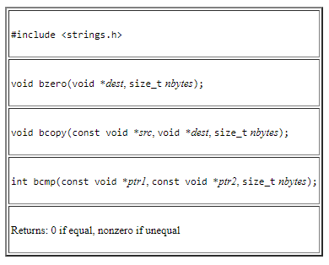
Byte Manipulation Functions
bzero sets the specified number of bytes to 0 in the destination. We often use this function to initialize a socket address structure to 0.
bcopy moves the specified number of bytes from the source to the destination.
bcmp compares two arbitrary byte strings.
The return value is zero if the two byte strings are identical; otherwise, it is nonzero.

Slide 26
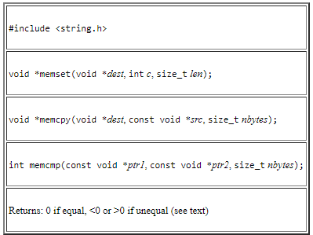
Byte Manipulation Functions
memset sets the specified number of bytes to the value c in the destination.
memcpy is similar to bcopy, but the order of the two pointer arguments is swapped.
bcopy correctly handles overlapping fields, while the behavior of memcpy is undefined if the source and destination overlap.
memcmp compares two arbitrary byte strings and returns 0 if they are identical.
If not identical, the return value is either greater than 0 or less than 0, depending on whether the first unequal byte pointed to by ptr1 is greater than or less than the corresponding byte pointed to by ptr2

Slide 27
fork() and exec()
Every application(program) comes into execution through means of process,
process is a running instance of a program.
Processes are created through different system calls, most popular are fork() and exec()

Slide 28
In Unix-like operating systems, the fork() function is used to create a new process by duplicating the calling process. The new process is called the child process, and the calling process is called the parent process. The child process is an exact copy of the parent process, including the same program code, data, heap, and stack.
Here is the syntax of the fork() function
include <unistd.h>
pid_t fork(void);
The fork() function takes no arguments and returns a value of type pid_t. In the parent process, the return value is the process ID (PID) of the child process, and in the child process, the return value is 0. If there is an error, the return value is -1.
The fork() function creates a new process by duplicating the calling process. The child process is an exact copy of the parent process, except for the following differences:
The child process has a new process ID.
The child process has a new parent process ID, which is the process ID of the parent process.
The child process has a new copy of the file descriptor table, which is a table that maps file descriptors to open files.
The child process has a new copy of the signal mask, which is a set of signals that are blocked for the process.
The child process has a new copy of the memory mappings, including the program code, data, heap, and stack.
After fork() returns, both the parent and child processes continue executing at the instruction after the fork() call. The two processes have separate copies of the data and heap, but share the same program code and file descriptors. The parent process can determine the process ID of the child process by examining the return value of fork(). The child process can determine whether it is the parent or the child by checking the return value of fork().

Slide 29
In Unix-like operating systems, the exec() family of functions is used to replace the current process image with a new process image. The new process image can be a different program file or a different version of the same program file.
Here are the six functions in the exec() family:
#include <unistd.h>
int execl(const char *path, const char *arg, ...);
int execle(const char *path, const char *arg, ..., char *const envp[]);
int execlp(const char *file, const char *arg, ...);
int execv(const char *path, char *const argv[]);
int execve(const char *path, char *const argv[], char *const envp[]);
int execvp(const char *file, char *const argv[]);
All of these functions take the path to the program file as the first argument. The difference between the functions is in how the arguments and environment variables are passed to the new process.
The execl() and execle() functions take a variable number of arguments, where the first argument is the path to the program file, and the remaining arguments are the command line arguments to be passed to the new process. The execle() function also takes an additional argument that is a pointer to the environment variables to be passed to the new process.
The execlp() and execvp() functions are similar to execl() and execv(), respectively, but they search the PATH environment variable to find the program file if the path argument does not contain a slash (/).
The execv() and execve() functions take an array of strings as the second argument, where the first element is the program name, and the remaining elements are the command line arguments to be passed to the new process. The execve() function also takes an additional argument that is a pointer to the environment variables to be passed to the new process.
When a process calls one of the exec() functions, the current process image is replaced with the new process image. All memory mappings, file descriptors, signal handlers, and signal masks are preserved, except for those that are explicitly modified by the new process image. If the exec() function returns, it means that there was an error.

Slide 30
fork vs exec
fork starts a new process which is a copy of the one that calls it, while exec replaces the current process image with another (different) one.
Both parent and child processes are executed simultaneously in case of fork() while Control never returns to the original program unless there is an exec() error.

Slide 31
Concurrent Server
In Unix network programming, a concurrent server is a server program that is capable of handling multiple client connections simultaneously.
This allows the server to provide concurrent services to multiple clients without blocking or delaying other requests.

Slide 32
Multi Process programming for concurrent Server
Multi-process programming: In this approach, the server program creates a new process for each client connection. Each process runs independently and handles the requests from the respective client. The parent process can use the fork() system call to create child processes, and the wait() system call to collect the exit status of terminated child processes.

Slide 33
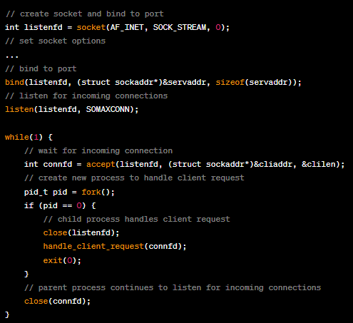

Slide 34
This loop continuously waits for incoming client connections using the accept() system call, which blocks until a new connection arrives. Once a new connection is established, a new child process is created using the fork() system call, which duplicates the current process. The child process then closes the listening socket using close(listenfd), since it no longer needs to accept new connections, and calls handle_client_request() to handle the client request. The parent process continues to listen for incoming connections by closing the connection socket connfd and going back to the beginning of the loop.
Overall, this code implements a simple multi-process concurrent server that can handle multiple client connections simultaneously by creating a new child process for each incoming connection.

Slide 35
Concurrent Servers
When a client request can take longer to service, we do not want to tie up a single server with one client; we want to handle multiple clients at the same time.
The simplest way to write a concurrent server under Unix is to fork a child process to handle each client.

Slide 36
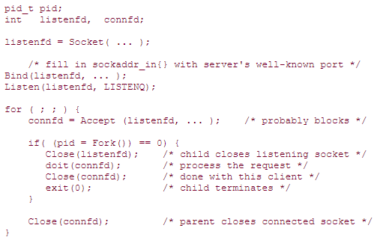
Concurrent server

Slide 37
Outline of a Concurrent Server
When a connection is established, accept returns, the server calls fork, and the child process services the client (on connfd, the connected socket) and the parent process waits for another connection (on listenfd, the listening socket).
The parent closes the connected socket since the child handles the new client.
the function doit does whatever is required to service the client.
When this function returns, we explicitly close the connected socket in the child

Slide 38

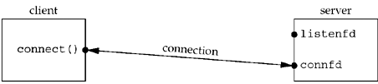
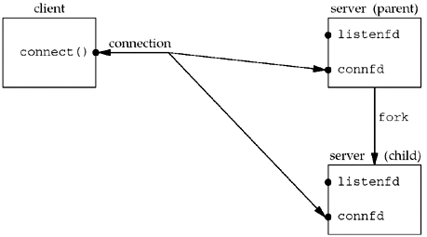
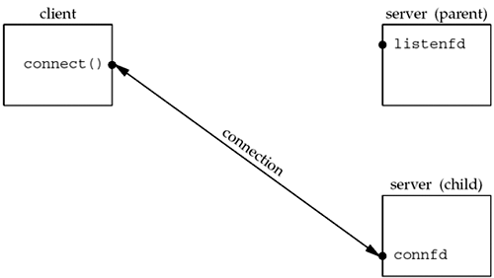
Status of client/server before call to accept returns.
Immediately after accept returns, we have the scenario shown in second figure
Status of client/server after return from accept.
Status of client/server after fork returns.
listenfd and connfd, are shared (duplicated) between the parent and child.
Status of client/server after parent and child close appropriate sockets.
The child is handling the connection with the client and the parent can call accept again on the listening socket, to handle the next client connection.

Slide 39
Socket()
In Unix network programming, the socket() function is
used to create a new communication endpoint, or socket, that can be used to send and receive data over a network.
The socket is identified by a socket descriptor, which is an integer value returned by the socket() function.

Slide 40
Socket()
The socket() function takes three arguments:
The domain, or address family, of the socket. This specifies the type of protocol to be used for communication. Common address families include AF_INET for IPv4, AF_INET6 for IPv6, and AF_UNIX for Unix domain sockets.
The type of socket, which determines the communication semantics. Common socket types include SOCK_STREAM for reliable, connection-oriented communication and SOCK_DGRAM for unreliable, connectionless communication.
The protocol to be used for communication. This is typically set to 0, which allows the operating system to choose the appropriate protocol based on the socket type and address family.

Slide 41
Socket()
#include <sys/types.h>
#include <sys/socket.h>
int sockfd;
sockfd = socket(AF_INET, SOCK_STREAM, 0); // create a TCP socket
In this example, we create a TCP socket by specifying the address family AF_INET for IPv4 and the socket type SOCK_STREAM for reliable, connection-oriented communication. The protocol argument is set to 0, which allows the operating system to choose the appropriate protocol.
After creating the socket, we can use the socket descriptor sockfd to send and receive data over the network.

Slide 42
socket system calls
bind
The bind() function is used to associate a socket with a specific network address, which is identified by a unique combination of IP address and port number. This function is called on the socket file descriptor that has been created earlier using the socket() system call.
The bind() function takes three arguments:
The socket file descriptor returned by the socket() call.
A pointer to a sockaddr structure that specifies the network address to bind to. The sockaddr structure must be cast to a sockaddr_in structure for Internet Protocol (IP) addresses, or to a sockaddr_un structure for Unix domain sockets.
The size of the sockaddr structure.

Slide 43
#include <sys/types.h>
#include <sys/socket.h>
#include <netinet/in.h>
#include <arpa/inet.h>
int sockfd;
struct sockaddr_in servaddr;
sockfd = socket(AF_INET, SOCK_STREAM, 0); // create a TCP socket
bzero(&servaddr, sizeof(servaddr)); // zero out the structure
servaddr.sin_family = AF_INET; // specify the address family
servaddr.sin_addr.s_addr = htonl(INADDR_ANY); // use any available network interface
servaddr.sin_port = htons(8080); // specify the port number
bind(sockfd, (struct sockaddr *)&servaddr, sizeof(servaddr)); // bind the socket to the address

Slide 44
In this example, sockfd is the socket file descriptor returned by the socket() call. We create a sockaddr_in structure named servaddr, and set its members to specify the IP address and port number we want to bind to. The INADDR_ANY macro is used to indicate that the socket should listen on all available network interfaces. Finally, we call bind() to associate the socket with the address specified in servaddr

Slide 45
Socket System Calls
Connect
In Unix network programming, the connect() system call is used to establish a connection to a remote host over a network. It is typically used by clients to connect to a server that is listening for incoming connections.
The connect() function takes three arguments:
The socket file descriptor returned by the socket() call.
A pointer to a sockaddr structure that specifies the address of the remote host to connect to. The sockaddr structure must be cast to a sockaddr_in structure for Internet Protocol (IP) addresses, or to a sockaddr_un structure for Unix domain sockets.
The size of the sockaddr structure.

Slide 46
#include <sys/types.h>
#include <sys/socket.h>
#include <netinet/in.h>
#include <arpa/inet.h>
int sockfd;
struct sockaddr_in servaddr;
sockfd = socket(AF_INET, SOCK_STREAM, 0); // create a TCP socket
bzero(&servaddr, sizeof(servaddr)); // zero out the structure
servaddr.sin_family = AF_INET; // specify the address family
servaddr.sin_addr.s_addr = inet_addr("192.168.1.100"); // specify the IP address
servaddr.sin_port = htons(8080); // specify the port number
connect(sockfd, (struct sockaddr *)&servaddr, sizeof(servaddr)); // connect to the remote host

Slide 47
In this example, sockfd is the socket file descriptor returned by the socket() call. We create a sockaddr_in structure named servaddr, and set its members to specify the IP address and port number of the remote host we want to connect to. The inet_addr() function is used to convert the IP address from string format to binary format. Finally, we call connect() to establish a connection to the remote host specified in servaddr.

Slide 48
Socket System Calls
Listen
In Unix network programming, the listen() system call is used to make a socket a listening socket that can accept incoming connections. A listening socket is used by servers to wait for incoming connections from clients.
The listen() function takes two arguments:
The socket file descriptor returned by the socket() call.
The maximum number of pending connections that the server can queue up before it starts rejecting new connections. This is typically set to a value between 1 and 128.

Slide 49
#include <sys/types.h>
#include <sys/socket.h>
int sockfd;
sockfd = socket(AF_INET, SOCK_STREAM, 0); // create a TCP socket
// bind the socket to a local address and port using bind()
listen(sockfd, 5); // make the socket a listening socket with a maximum queue length of 5

Slide 50
In this example, we create a TCP socket using socket() and bind it to a local address and port using the bind() function (not shown in this code snippet). We then call listen() to make the socket a listening socket with a maximum queue length of 5. This means that the server can handle up to 5 pending connections before it starts rejecting new connections.
Once the socket is a listening socket, the server can use the accept() function to accept incoming connections from clients.

Slide 51
Socket System Calls
accept()
In Unix network programming, the accept() system call is used to accept an incoming connection request on a listening socket. The accept() function blocks until a connection is established with a client, and returns a new socket descriptor that is used to communicate with the client.
The accept() function takes three arguments:
The socket file descriptor returned by the listen() call.
A pointer to a sockaddr structure that will be filled in with the address of the client.
A pointer to an integer that will be filled in with the size of the sockaddr structure.

Slide 52
#include <sys/types.h>
#include <sys/socket.h>
int sockfd, connfd;
struct sockaddr_in cliaddr;
socklen_t clilen;
sockfd = socket(AF_INET, SOCK_STREAM, 0); // create a TCP socket
// bind the socket to a local address and port using bind()
listen(sockfd, 5); // make the socket a listening socket with a maximum queue length of 5
clilen = sizeof(cliaddr);
connfd = accept(sockfd, (struct sockaddr *)&cliaddr, &clilen); // accept an incoming connection request
// use connfd to communicate with the client

Slide 53
In this example, we create a TCP socket using socket() and bind it to a local address and port using the bind() function (not shown in this code snippet). We then call listen() to make the socket a listening socket with a maximum queue length of 5.
We use the accept() function to accept an incoming connection request, which blocks until a connection is established with a client. The cliaddr variable is a sockaddr_in structure that is filled in with the address of the client, and clilen is a variable that is initialized to the size of the cliaddr structure.
The accept() function returns a new socket descriptor connfd that is used to communicate with the client. We can use this socket descriptor to send and receive data to and from the client.

Slide 54
Socket System Calls
send, sendto, recv and recvfrom
In Unix network programming, the send(), sendto(), recv(), and recvfrom() system calls are used to send and receive data over network sockets.
The send() function is used to send data on a connected socket. It takes four arguments:
The socket file descriptor returned by the socket() call.
A pointer to a buffer containing the data to be sent.
The size of the data to be sent.
Flags, which can be used to control the behavior of the send operation. This argument is typically set to 0.
Notes:
The to argument for sendto specifies the protocol-specific address of where the data is to be sent.
The recvfrom system call fills in the protocol-specific address of who sent the data into from.

Slide 55
#include <sys/types.h>
#include <sys/socket.h>
int sockfd;
char buf[1024] = "Hello, world!";
sockfd = socket(AF_INET, SOCK_STREAM, 0); // create a TCP socket
// connect to a remote server using connect()
send(sockfd, buf, sizeof(buf), 0); // send data on the connected socket

Slide 56
In this example, we create a TCP socket using socket() and connect to a remote server using the connect() function (not shown in this code snippet). We then call send() to send data on the connected socket.

Slide 57
sendto()
The sendto() function is similar to send(), but it is used to send data on a connectionless socket, such as a UDP socket. It takes five arguments:
The socket file descriptor returned by the socket() call.
A pointer to a buffer containing the data to be sent.
The size of the data to be sent.
Flags, which can be used to control the behavior of the send operation. This argument is typically set to 0.
A pointer to a sockaddr structure containing the address of the remote host.

Slide 58
recv()
The recv() function is used to receive data on a connected socket. It takes four arguments:
The socket file descriptor returned by the socket() call.
A pointer to a buffer where the received data will be stored.
The size of the buffer.
Flags, which can be used to control the behavior of the receive operation. This argument is typically set to 0.

Slide 59
#include <sys/types.h>
#include <sys/socket.h>
int sockfd;
char buffer[1024];
int bytes_received;
sockfd = socket(AF_INET, SOCK_STREAM, 0); // create a TCP socket
// connect to the remote host using connect()
bytes_received = recv(sockfd, buffer, sizeof(buffer), 0); // receive data on the connected socket

Slide 60
In this example, we create a TCP socket using socket() and bind it to a local address and port using the bind() function (not shown in this code snippet). We then call listen() to make the socket a listening socket with a maximum queue length of 5.

Slide 61
recvFfrom()
The recvfrom() system call is used to receive data on a datagram socket. It takes the following arguments:
The socket file descriptor
A pointer to the buffer where the received data will be stored
The maximum length of the data to be received
A set of flags that control the behavior of the function
A pointer to the buffer where the source address of the data will be stored
A pointer to the length of the source address buffer
The recvfrom() function returns the number of bytes received on success, or 0 if the remote side has closed the connection, or -1 on error. The source address of the data is stored in the sockaddr structure pointed to by the src_addr argument, and the length of the source address is stored in the integer pointed to by the addrlen argument.

Slide 62
Socket System Calls
close
The normal Unix close system call is also used to close a socket.
int close(int fd);
If the socket being closed is associated with a protocol that promises reliable delivery (e.g., TCP or SPP), the system must assure that any data within the kernel that still has to be transmitted or acknowledged, is sent.

Slide 63
UNIX/INTERNET Domain Socket
UNIX Domain Socket
UNIX domain sockets are a type of inter-process communication mechanism that allows communication between processes on the same host operating system.
They are implemented as a special file type in the file system, and processes can read from and write to them in the same way they would with regular files.
One of the benefits of UNIX domain sockets is that they provide a faster and more secure way of inter-process communication than other mechanisms like pipes or message queues. They can be used for a variety of purposes, such as communication between different components of a single application, or communication between different applications running on the same machine.
Internet domain sockets:
used for communication over a network, allowing processes to communicate across different machines.
They are identified by an IP address and a port number, and can be used with protocols such as TCP or UDP.
Internet domain sockets are widely used in client-server applications, where one process acts as a server and waits for incoming connections from multiple clients.

Slide 64
Unix domain socket aka UDS or IPC socket
A Unix domain socket aka UDS or IPC socket (inter-process communication socket)
It is also referred to by its address family AF_UNIX.
Valid socket types in the UNIX domain are:
SOCK_STREAM (compare to TCP) – for a stream-oriented socket
SOCK_DGRAM (compare to UDP) – for a datagram-oriented socket that preserves message boundaries (as on most UNIX implementations, UNIX domain datagram sockets are always reliable and don't reorder datagrams)
SOCK_SEQPACKET (compare to SCTP) – for a sequenced-packet socket that is connection-oriented, preserves message boundaries, and delivers messages in the order that they were sent

Slide 65
File descriptor
A file descriptor is a unique integer that identifies an open file or input/output (I/O) stream.
When a process opens a file, socket, or other I/O stream, the operating system assigns a file descriptor to it, which the process can use to read from or write to the stream.
File descriptors are managed by the process's file descriptor table, which is an array of file descriptor entries. Each entry in the table contains information about the corresponding open file or socket, including the current position in the file or stream, any associated flags, and the underlying file system or network socket.
File descriptors are used extensively in Unix system programming to perform I/O operations on files and sockets.
For example, the read() and write() system calls take a file descriptor as an argument, along with a buffer and a size, to read or write data to the open file or socket.

Slide 66
Passing file descriptors
Passing file descriptors is a mechanism used in Unix for sharing resources between processes or transferring ownership of a resource from one process to another.
This mechanism allows a process to pass a file descriptor to another process over a socket connection, allowing the receiving process to access the resource identified by the file descriptor.
The process of passing a file descriptor between processes involves several steps:
The sending process creates a socket connection with the receiving process.
The sending process opens the file or creates a socket that it wants to share and obtains a file descriptor for it.
The sending process sends a message containing the file descriptor over the socket connection to the receiving process using the sendmsg() system call.
The receiving process receives the message using the recvmsg() system call and extracts the file descriptor from the ancillary data object.
The receiving process can then use the file descriptor to access the shared resource

Slide 67
The Unix Filesystem
The process table
Managing processes is one of the kernel's biggest responsibilities.
It decides which process actually gets to run on the CPU (or CPUs) at any point in time.
The kernel keeps a data structure (in kernel space) to track information about processes: the process table.
File I/O
When a process opens a file and reads or writes, we can identify several entities involved:
The actual file on the harddrive,
the kernel's record that stores in memory (i.e. RAM) basic file info - like permissions, location on the harddrive, etc,
the kernel's record relating to that processes's connection to the file (after all, many processes may be reading from the file at the same time, or maybe the same process has several different connections reading from the file simultaneously, but at different locations), and
the number that the process uses to tell the kernel which file-connection it's trying to read-from/write-to.
The basic system calls for dealing with file I/O are
open, which requests that a connection to a file be made;
close, which requests that a connection to a file be closed;
read, which requests that some bytes be read from a file via a specified connection; and
write, which requests that some bytes be written to a file via a specified connection.

Slide 68
The Unix Filesystem
Unix I/O: file descriptors
Unix's model of of files is simple:
files are just sequences of bytes.
User programs may impose structure or meaning on those bytes
System Open File Table
The system needs to keep track of each "connection" to a file.
Since distinct processes may even share a connections (say two processes wanted to write to the same log file, each adding new data to the end of the file), the "connection" information cannot be kept inside the process table. So the kernel keeps a data structure called the system open-file table which has an entry for each connection. Each entry contains the connection status, e.g. read or write, the current offset in the file, and a pointer to a vnode, which is the OS's structure representing the file, irrespective of where in the file you may currently be looking. (Note: Linux names their vnode-ish data structure "generic inodes".)

Slide 69
The Unix Filesystem
Vnode Table
The kernel keeps yet another table, the Vnode table, which has an entry for each open file or device.
Each entry, called a Vnode, contains information about the type of file and pointers to functions that operate on the file.
Typically for files, the vnode also contains a copy of the inode for the file, which has "physical" information about the file, e.g. where exactly on the disk the file's data resides

Slide 70
Passing file descriptor
https://www.sobyte.net/post/2022-01/pass-fd-over-domain-socket/\
https://www.sobyte.net/post/2022-01/pass-fd-over-domain-socket/
https://flylib.com/books/en/3.224.1.265/1/

Slide 71
I/O models
There are normally two distinct phases for an input/output operation:
Waiting for the data to be ready. This involves waiting for data to arrive on the network. When the packet arrives, it is copied into a buffer within the kernel.
Copying the data from the kernel to the process. This means copying the (ready) data from the kernel's buffer into our application buffer
There are five I/O models available under Unix:
blocking I/O
nonblocking I/O
I/O multiplexing (select and poll)
signal driven I/O (SIGIO)
asynchronous I/O (the POSIX aio_ functions)

Slide 72
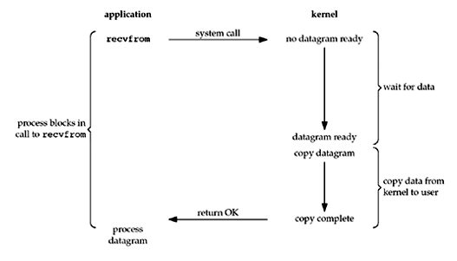
Blocking I/O Model

Slide 73
Blocking I/O Model
By default, all sockets are blocking.
The process calls recvfrom and the system call does not return until the datagram arrives and is copied into our application buffer, or an error occurs.
the process is blocked the entire time from when it calls recvfrom until it returns
When recvfrom returns successfully, our application processes the datagram.

Slide 74
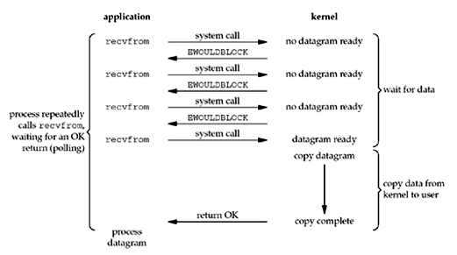
Nonblocking I/O Model
When a socket is set to be nonblocking, we are telling the kernel "when an I/O operation that I request cannot be completed without putting the process to sleep, do not put the process to sleep, but return an error instead"

Slide 75
Nonblocking I/O Model
For the first three recvfrom, there is no data to return and the kernel immediately returns an error of EWOULDBLOCK.
For the fourth time we call recvfrom, a datagram is ready, it is copied into our application buffer, and recvfrom returns successfully. We then process the data.
When an application sits in a loop calling recvfrom on a nonblocking descriptor like this, it is called polling. The application is continually polling the kernel to see if some operation is ready. This is often a waste of CPU time, but this model is occasionally encountered, normally on systems dedicated to one function.

Slide 76
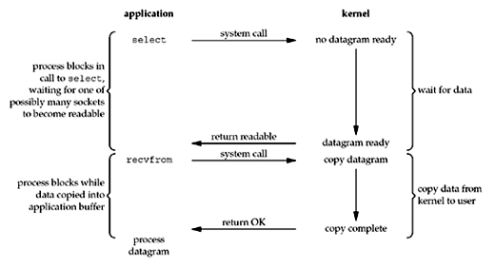
I/O Multiplexing Model
With I/O multiplexing, we call select or poll and block in one of these two system calls, instead of blocking in the actual I/O system call.

Slide 77
I/O Multiplexing Model
We block in a call to select, waiting for the datagram socket to be readable. When select returns that the socket is readable, we then call recvfrom to copy the datagram into our application buffer.
Comparing to the blocking I/O model
Disadvantage: using select requires two system calls (select and recvfrom) instead of one
Advantage: we can wait for more than one descriptor to be ready
Notes:
The select function allows the process to instruct the kernel to either:
Wait for any one of multiple events to occur and to wake up the process only when one or more of these events occurs, or
When a specified amount of time has passed.

Slide 78
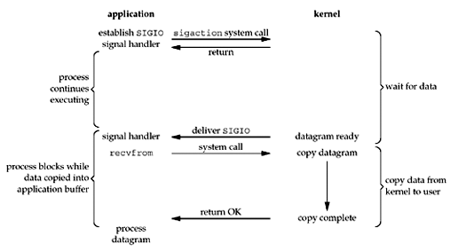
Signal-Driven I/O Model
The signal-driven I/O model uses signals, telling the kernel to notify us with the SIGIO signal when the descriptor is ready.

Slide 79
Signal-Driven I/O Mode
We first enable the socket for signal-driven I/O and install a signal handler using the sigaction system call. The return from this system call is immediate and our process continues; it is not blocked.
When the datagram is ready to be read, the SIGIO signal is generated for our process. We can either:
read the datagram from the signal handler by calling recvfrom and then notify the main loop that the data is ready to be processed
notify the main loop and let it read the datagram.

Slide 80
Asynchronous I/O Model
Asynchronous I/O is defined by the POSIX specification that appeared in the various standards
These functions work by telling the kernel to start the operation and to notify us when the entire operation (including the copy of the data from the kernel to our buffer) is complete
The main difference between this model and the signal-driven I/O model is that with signal-driven I/O, the kernel tells us when an I/O operation can be initiated, but with asynchronous I/O, the kernel tells us when an I/O operation is complete.

Slide 81
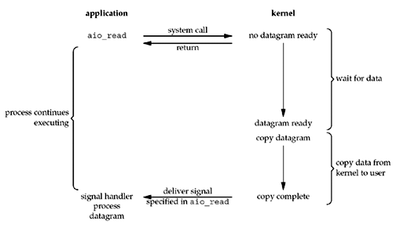
Asynchronous I/O Model

Slide 82
Asynchronous I/O Model
We call aio_read (the POSIX asynchronous I/O functions begin with aio_ or lio_) and pass the kernel the following:
descriptor, buffer pointer, buffer size (the same three arguments for read),
file offset (similar to lseek),
and how to notify us when the entire operation is complete.
This system call returns immediately and our process is not blocked while waiting for the I/O to complete.
We assume in this example that we ask the kernel to generate some signal when the operation is complete. This signal is not generated until the data has been copied into our application buffer, which is different from the signal-driven I/O model.

Slide 83
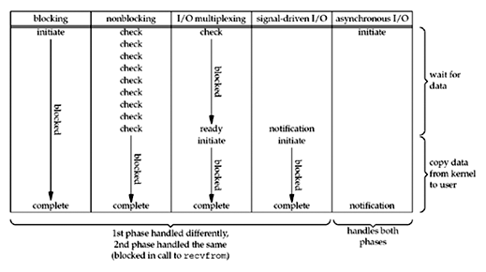
Comparison of the I/O Models

Slide 84
Synchronous I/O versus Asynchronous I/O
POSIX defines these two terms as follows:
A synchronous I/O operation causes the requesting process to be blocked until that I/O operation completes
An asynchronous I/O operation does not cause the requesting process to be blocked.
Using these definitions, the first four I/O models (blocking, nonblocking, I/O multiplexing, and signal-driven I/O) are all synchronous because the actual I/O operation (recvfrom) blocks the process. Only the asynchronous I/O model matches the asynchronous I/O definition.

Slide 85
socket options
socket options are parameters that can be set on a socket to control its behavior.
In network programming, the getsockopt() and setsockopt() functions are used to get and set the socket options, respectively.
These functions are typically called on a socket after it has been created and bound, but before it is used to send or receive data.

Slide 86
getsockopt()
int getsockopt(int sockfd, int level, int optname, void *optval, socklen_t *optlen);
sockfd: the socket file descriptor to retrieve the option from.
level: the protocol level at which the option resides. This is typically set to SOL_SOCKET to retrieve socket-level options.
optname: the name of the option to retrieve. This can be one of the predefined constants or a custom option defined by the application.
optval: a pointer to a buffer where the value of the option will be stored.
optlen: a pointer to the size of the buffer pointed to by optval.
The setsockopt() function sets the value of a specified socket option. It takes five arguments:

Slide 87
setsockopt()
int setsockopt(int sockfd, int level, int optname, const void *optval, socklen_t optlen);
sockfd: the socket file descriptor to set the option on.
level: the protocol level at which the option resides.
optname: the name of the option to set.
optval: a pointer to the buffer containing the new value of the option.
optlen: the size of the buffer pointed to by optval.

Slide 88
Some common options that can be set using setsockopt() and retrieved using getsockopt() include:
SO_REUSEADDR: allows reuse of local addresses.
SO_KEEPALIVE: enables sending periodic keep-alive messages on the socket.
SO_SNDBUF and SO_RCVBUF: set the size of the send and receive buffers.
SO_LINGER: controls the behavior of a socket when it is closed.
TCP_NODELAY: disables the Nagle algorithm.

Slide 89
fnctl
The fcntl function, short for "file control," is a system call in Unix-like operating systems that allows manipulation of file descriptors. It provides a way to perform various operations on open file descriptors that are not covered by other system calls.
#include <fcntl.h>
int fcntl(int fd, int cmd, ... /* arg */);
fd: The file descriptor on which the operation will be performed.
cmd: The specific operation to be carried out, represented by predefined constants such as F_GETFL, F_SETFL, F_DUPFD, etc.
arg: Additional arguments that depend on the operation being performed. It can be an integer, a structure, or a pointer to a structure, depending on the specific operation.
The fcntl function returns a value that depends on the specific operation:
For some operations, it returns a positive value indicating success or the requested information.
For other operations, it returns -1 on failure, and you can check the errno variable to determine the cause of the error.

Slide 90
Daemon Processes
Daemons are processes that are often started when the system is bootstrapped and terminate only when the system is shut down.
Because they don’t have a controlling terminal, they run in the background.
UNIX systems have numerous daemons that perform day-to-day activities.
Since a daemon does not have a controlling terminal, we need to see how a daemon can report error conditions when something goes wrong.

Slide 91
Daemon Process: Error Logging
One problem a daemon has is how to handle error messages. It cannot (simply) write to:
Standard error: it shouldn't have a controlling terminal.
Console device: on many workstations the console device runs a windowing system.
Separate files: it's a headache to keep up which daemon writes to which log file and to check these files on a regular basis.
A central daemon error-logging facility is required. Most daemons use this facility.

Slide 92
Daemon Process: Error Logging
There are three ways to generate log messages:
Kernel routines can call the log function. These messages can be read by any user process that opens and reads the /dev/klog device.
Most user processes (daemons) call the syslog(3) function to generate log messages. This causes the message to be sent to the UNIX domain datagram socket /dev/log.
A user process on this host or some other host that is connected to this host by a TCP/IP network, can send log messages to UDP port 514. Note that the syslog function never generates these UDP datagrams: they require explicit network programming by the process generating the log message.

Slide 93
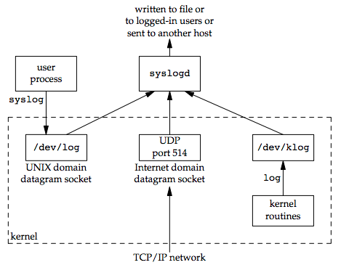
Daemon Process: Error Logging
The syslogd daemon reads all three forms of log messages. On start-up, this daemon reads a configuration file, usually /etc/syslog.conf, which determines where different classes of messages are to be sent.

Slide 94
ioctl () function
IOCTL is referred to as Input and Output Control, which is used to talking to device drivers
The major use of this is in case of handling some specific operations of a device for which the kernel does not have a system call by default.
#include <unistd.h>
int ioctl(int fd,int request,...../* void *arg/);
//Return: 0 if successful, -1 if failed
The third parameter is always a pointer, but the type of the pointer depends on the request parameter

Slide 95
ioctl function
There are 6 types of ioctl requests related to the network:
Socket operation
File operations
Interface operation
ARP cache operation
Routing table operations
Flow system
Notes:
ARP stands for Address Resolution Protocol, which is used to find the address of a network neighbor for a given IPv4 address.

Slide 96
Socket and operation
category | request | description | type of data
Socket | SIOCATMASK | Is it on the out-of-band sign | int
 | SIOCSPGRP | Set the process ID and process group ID of the socket | int
 | SIOCGPGPR | Get the process ID and process group ID of the socket | int
File operations | FIONBIO | Set/clear non-blocking flag | int
 | FIOASYNC | Set/clear asynchronous I/O flag | int
 | FIONREAD | Get the number of bytes of data in the receive buffer | int
 | FIOSETOWN | Set the process ID or process group ID of the file | int
 | FIOGETOWN | Get the process ID or process group ID of the file | int

Slide 97
category | request | description | type of data
interface | SIOCGIFCONF | Get a list of all interfaces | struct ifconf
 | SIOCSIFADDR | Set interface address | struct ifreq
 | SIOCGIFADDR | Get interface address | struct ifreq
 | SIOCSIFFLAGS | Set interface flag | struct ifreq
ARP | SIOCSARP | Create/modify ARP entries | struct arpreq
 | SIOCGARP | Get ARP entries | struct arpreq
 | SIOCDARP | Delete ARP entry | struct arpreq
 | SIOCSARP | Create/modify ARP entries | struct arpreq
routing | SIOCADDRT | Increase path | struct rtentry
 | SIOCDELRT | Delete path | struct rtentry

Slide 98
Socket Implementation
https://www.tutorialspoint.com/unix_sockets/socket_quick_guide.htm

